Slide 1

An Algorithm to Learn the Structure of a Bayesian Network
Çiğdem Gündüz
Olcay Taner Yıldız
Ethem Alpaydın
Computer Engineering
Taner Bilgiç
Industrial Engineering
Boğaziçi University

Slide 2
Bayesian Networks
Graphical model to encode probabilistic relationships among data
Consists of
  Directed Acyclic Graph (DAG)
  Conditional Probabilities

Slide 3
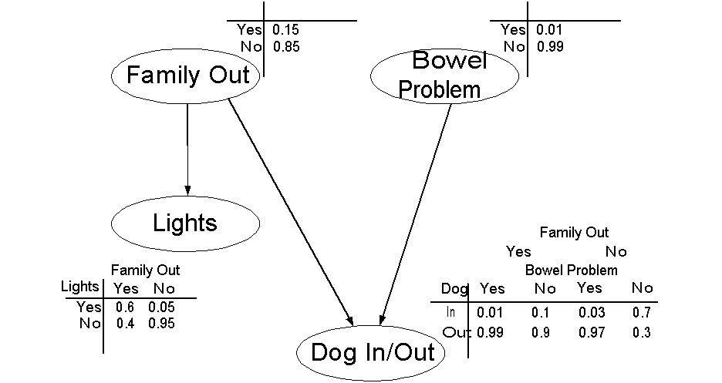
Example Bayesian Network

Slide 4
Issues in Bayesian Networks
Given data, learning the structure of the Bayesian Network (NP-Complete)
  Finding the arcs (dependencies) between the nodes
  Calculating conditional probability tables
Given the Bayesian Network, finding an efficient algorithm for inference on a given structure (NP-Complete)

Slide 5
Structure Learning Algorithms
Based on a maximization of a measure
  Likelihood
Using Independence Criteria
  Representing as much as the original dependencies in the data
Hybrid of the former two
  Our algorithm is in this group

Slide 6
Conditional Independence
Variable X and Y are conditionally independent ⇔ ∀ X, Y and Z, P ( X | Y, Z ) = P ( X | Z ), whenever P ( Y, Z ) > 0
Cardinality of Z indicates the order of conditional independency

Slide 7
Our Algorithm
Obtain the undirected graph using 0 and 1 independencies
Find the ordering that minimizes the size of the conditional tables
Using modify (change direction of the arc) and remove arc obtain final network
Calculate conditional probability tables

Slide 8
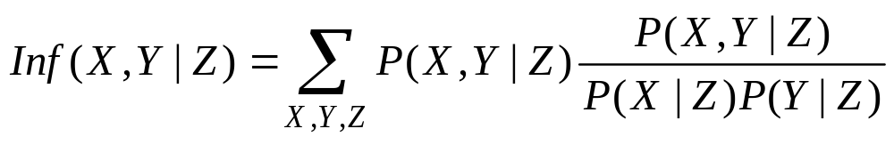
Obtaining the Undirected Graph
Find 0 and 1 independences using Mutual Information Test
Add edges according to 0 and 1 independences until the graph is connected

Slide 9
Variable Ordering Algorithm
For each variable
  Assign all neighbor edges as incoming arcs
  Compute size of the conditional tables
  Mark variable as unselected
While there are unselected nodes
  Select the node with the minimum table size
  Put the node in the ordering list
  Mark node as selected
  Adjust conditional table size of unselected nodes

Slide 10
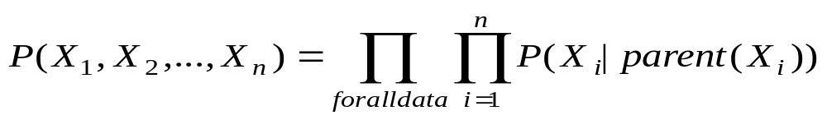
Learning Steps
Calculate likelihood of the data before and after applying the two operators on cv set
If the operator improves the likelihood we accept that operator
We continue until there is no improvement

Slide 11
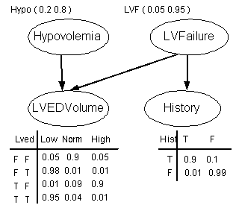
Learning of a 4 node Network

Slide 12
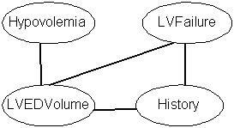
Obtaining Undirected Graph

Slide 13
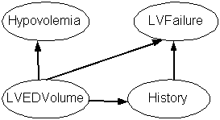
Obtaining DAG

Slide 14
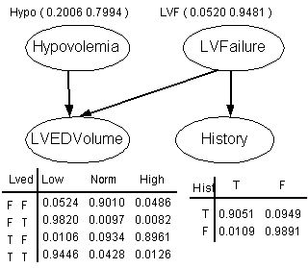
Obtaining Conditional Tables

Slide 15
Results on the Original Alarm Network
Original Graph has 46 arcs
Our algorithm has only 3 missing arcs
11 arcs are inverted
There are 23 extra arcs
D-separation can also be used to remove unnecessary arcs

Slide 16
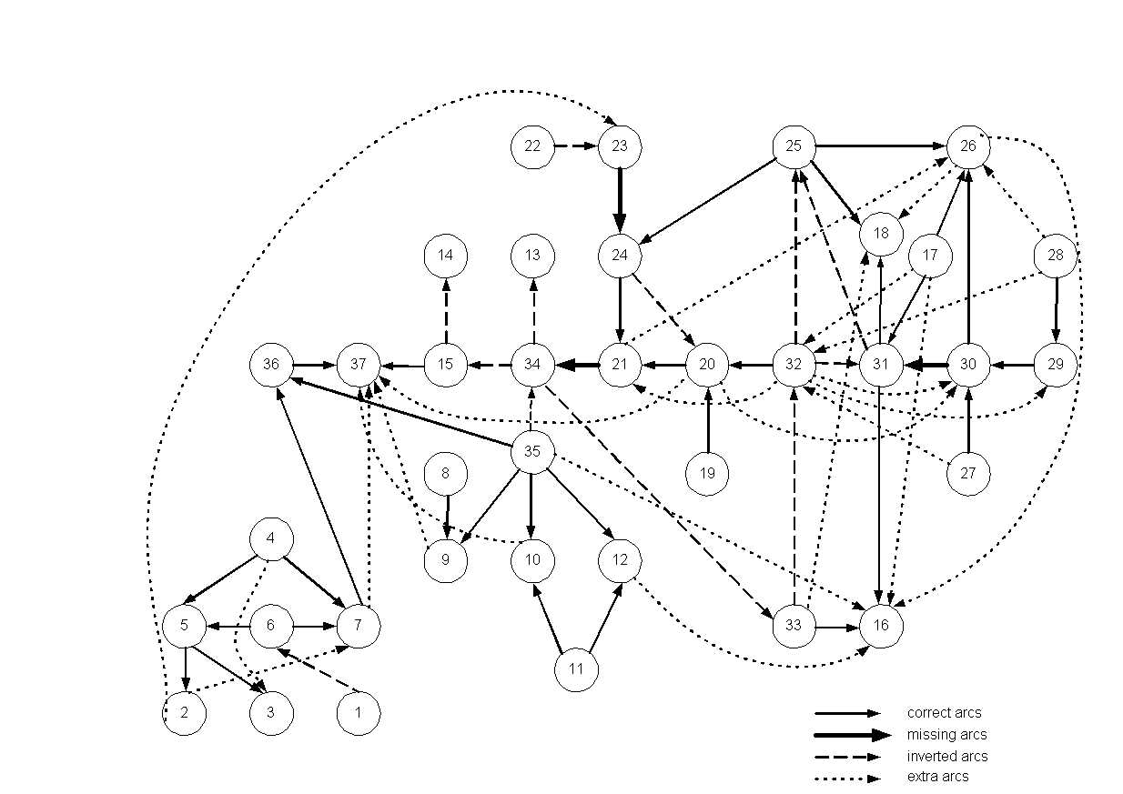
Alarm Network

Slide 17
Conclusion
A novel algorithm for learning the structure of Bayesian Network is proposed
Algorithm runs well in small networks
  Similar likelihoods with the original network
  Similar structures with the right directions
The algorithm heavily depends on data as all 0 and 1 independence tests are based on a statistical test.

Slide 18
Future Work
Missing variables can be filled with EM algorithm
We can add further operators such as adding hidden nodes with appropriate arcs
To check the validity of our algorithm we can use several classification data sets and use the model we learned to make classifications

